Slide 1
Atomic Theory: Spectroscopy and Flame Test

Slide 2
Atomic Absorption & Emission
Objectives:
Explain how the transition of electrons between energy levels can produce atomic absorption and emission line spectra.
Explain how flame tests and atomic absorption spectroscopy (AAS) can be used to identify elements.

Slide 3
Bohr’s model was helpful:
Explained atomic spectra
Gave a model for electronic structure.
It was also revolutionary:
Used idea of quantisation of energy, electrons can only have certain amounts of energy (quanta).

Slide 4
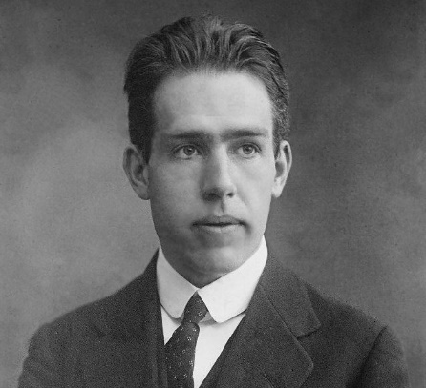
NIELS BOHR (1885–1962)
Niels Bohr was a Danish physicist and is considered one of the founding fathers of quantum mechanics, precisely old quantum mechanics. For his exemplary contributions to science, the Carlsberg brewing company decided to give him a house situated right next to one of their breweries. The house was connected to the brewery by a pipeline. Bohr was rewarded with a lifetime supply of free beer that would pour out of a tap at his whim. What extraordinary feat did Niels Bohr accomplish to deserve this prestigious honor, and well, a Nobel Prize?

Slide 5
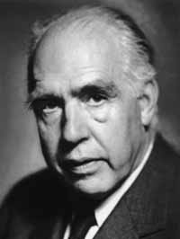
During the Nazi occupation of Denmark in World War II, tDuring the Nazi occupation of Denmark in World War II, Bohr escaped to the United States, where he became associated with the Atomic Energy Project.h
In his final years, he devoted himself to the peaceful application of atomic physics and to resolving political problems arising from the development of atomic weapons.

Slide 6


Slide 7
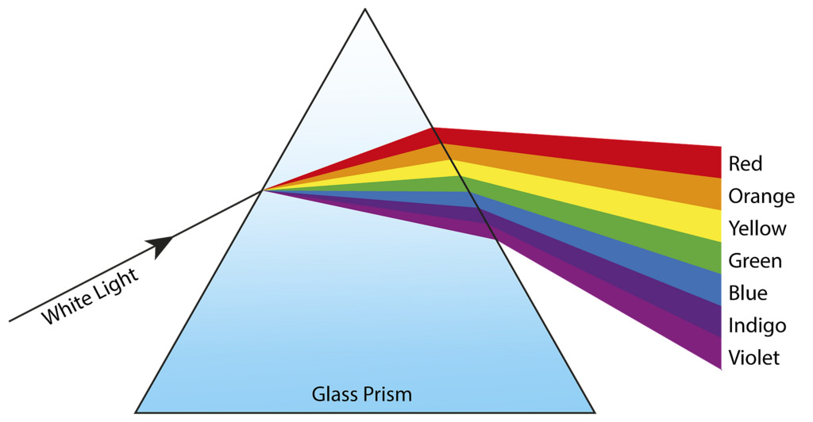
When light shines through a prism, the light separates into pattern of colours. The pattern of colours is called a spectrum. Each colour of spectrum represents different wave length.

Slide 8
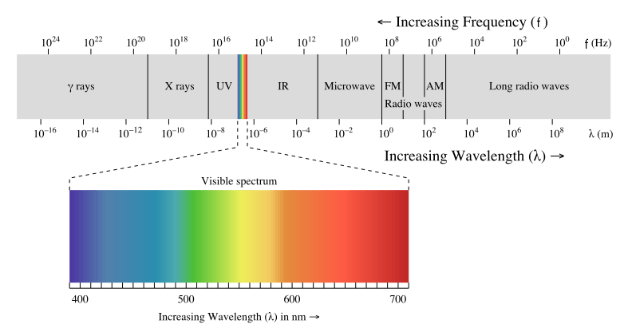

Slide 9
Light: Wave or particle?
Two models to describe behaviour of light:
Wave model
Particle model
Neither fully explains properties of light
Choose the model most appropriate to the situation.

Slide 10
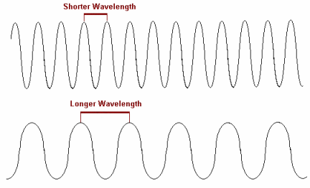
Wave theory of light
Wavelength (λ) = distance between peaks, in metres (m).
Frequency (ν) = number of cycles per second, in Hertz (Hz).

Slide 12
c = V λ
Speed of light is same for all types of electromagnetic radiation: 3.00 x 10⁸ m/s
Wave speed, frequency & wavelength related by the wave equation:
Speed of light = 3 x 10⁸ m/s
Frequency in Hz (s⁻¹)
Wavelength in m

Slide 13
Particle theory of light
Idea first proposed by Einstein in 1905.
Light is a stream of photons – tiny packets of energy.
Photons have no mass.

Slide 14
Energy of photon related to frequency of light wave by the Planck constant.
Planck Constant = 6.63 x 10⁻³⁴ Js (JHz⁻¹)
E = h v
Energy of photon in J
Frequency in Hz (s⁻¹)

Slide 15
Atomic Spectra
Atoms can absorb energy, and become excited (in a higher energy state) by:
Heat
Electric discharge
Electromagnetic radiation (photons)
Then they emit energy as electromagnetic radiation (UV, visible and IR photons), and return to their ground state.

Slide 16
Bozeman
https://www.youtube.com/watch?v=GhAn8xZQ-d8

Slide 17
This one: Crash Chemistry Academy
https://www.youtube.com/watch?v=apuWi_Fbtys

Slide 18
https://www.youtube.com/watch?v=1uPyq63aRvg

Slide 19
Atomic Spectra
Atoms can absorb energy, and become excited (in a higher energy state) by:
Heat
Electric discharge
Electromagnetic radiation (photons)
Then they emit energy as electromagnetic radiation (UV, visible and IR photons), and return to their ground state.

Slide 20
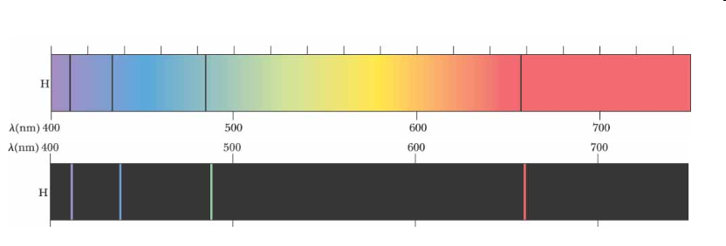
Absorption spectrum of hydrogen
Emission spectrum of hydrogen

Slide 21
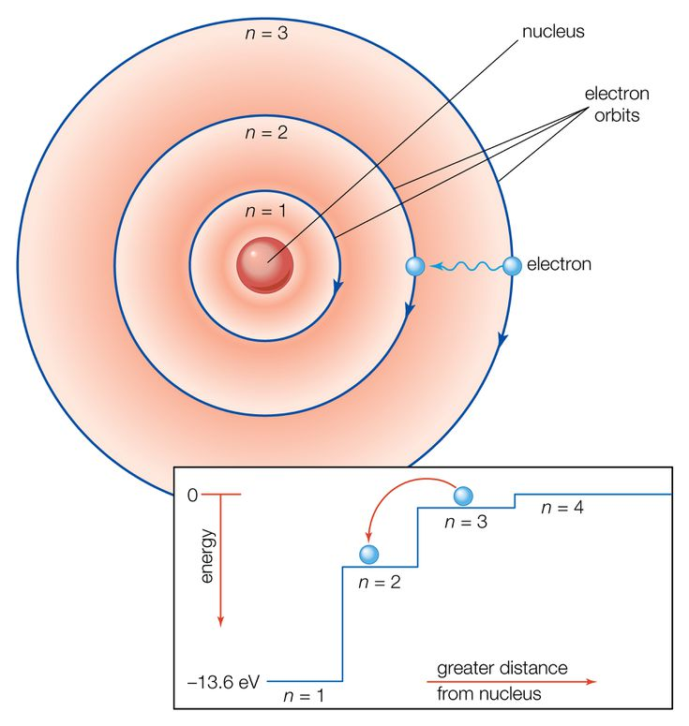
Bohr’s model of the atom
Electrons exist in discrete energy levels – they cannot have intermediate energies.
A photon can be emitted or absorbed when an electron moves between energy levels.
The energy of the photon corresponds to the difference between energy levels (ΔE).
Frequency of photon found by ΔE = hν.

Slide 22
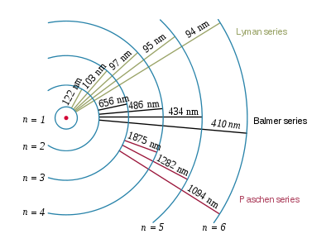

Slide 24
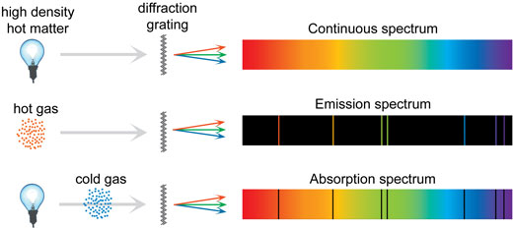
Absorption vs Emission

Slide 25
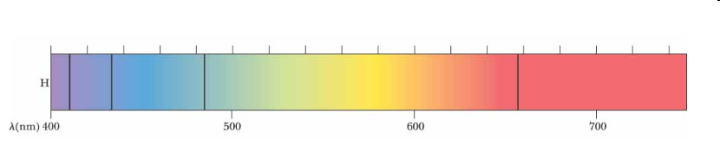
Absorption Spectra
Atom absorbs a photon, electron promoted to higher energy state.
Continuous spectrum of light has a specific frequencies of light missing – black lines on a continuous spectrum.

Slide 26
Atomic Absorption Spectroscopy
Uses absorption spectra.
Sample of substance is vapourised (atomised), light of specific frequencies shone through it (from a hollow cathode lamp of same element being tested for), atoms absorb photons as electrons are promoted, remaining light has frequencies missing.
Specific frequencies missing identify the element. Intensity of absorptions gives concentration of metal in sample.
Useful for identifying metals in water, biological tissue, mineral samples, etc.

Slide 27
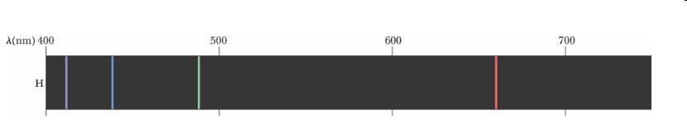
Emission Spectra
Atom becomes excited, electrons are already in higher energy levels.
Electron drops down to lower energy level.
Only specific frequencies of light are emitted – coloured lines on a black background.

Slide 28
Energy level diagram
Level 6
Level 5
Level 4
Energy
Level 3
Level 2
Level 1
Absorption
Emission

Slide 29
The absorption spectra and emission spectra for each element superimpose exactly.
Each element’s energy levels are slightly different, no two elements have the same spectra.

Slide 30
Absorption and emission spectra can be used to identify elements as each element’s spectra are unique. This is due to the differing nuclear charge on each atom.
The intensity of the absorption or emission lines tells you the abundance of the element.

Slide 31
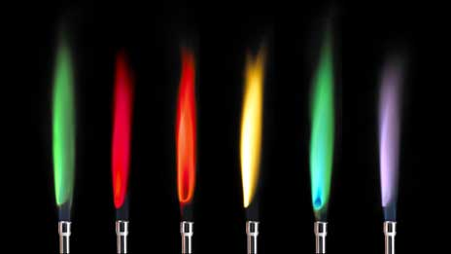
Flame Tests
Uses emission spectra.
Heat a sample of the substance (eg: colourless bunsen flame), electrons are excited, drop back to ground state, emit photons at characteristic frequencies.
Combination of photon frequencies produces a visible colour, which can be used to identify the element.
Light can be viewed through a spectroscope to see the emission lines and improve identification.

Slide 32
LIMITATIONS OF THE FLAME TEST
Only small number of metal ions can be distinguished in this way as Bunsen flame is not hot enough to excite the electrons of many atoms.
It is difficult to distinguish between very similar colours.
The colours may also be affected by the presence of traces of other ions.

Slide 33

How are wavelength and frequency related?
Directly
Inversely
2. A student burns a wood splint soaked in solution of calcium nitrate, Ca(NO₃)₂, and it burns a brick red colour. Is it the electrons in the calcium ion or the nitrate ion that is causing the observed colour?

Slide 34
1. Why an atom of hydrogen has more spectral lines than electrons.
An electron can be promoted to multiple levels
2. The flame of sodium chloride salt burned in ethanol appears yellow. Why yellow is the colour observed?
Majority of electron transitions emit energy corresponding to yellow light

Slide 35
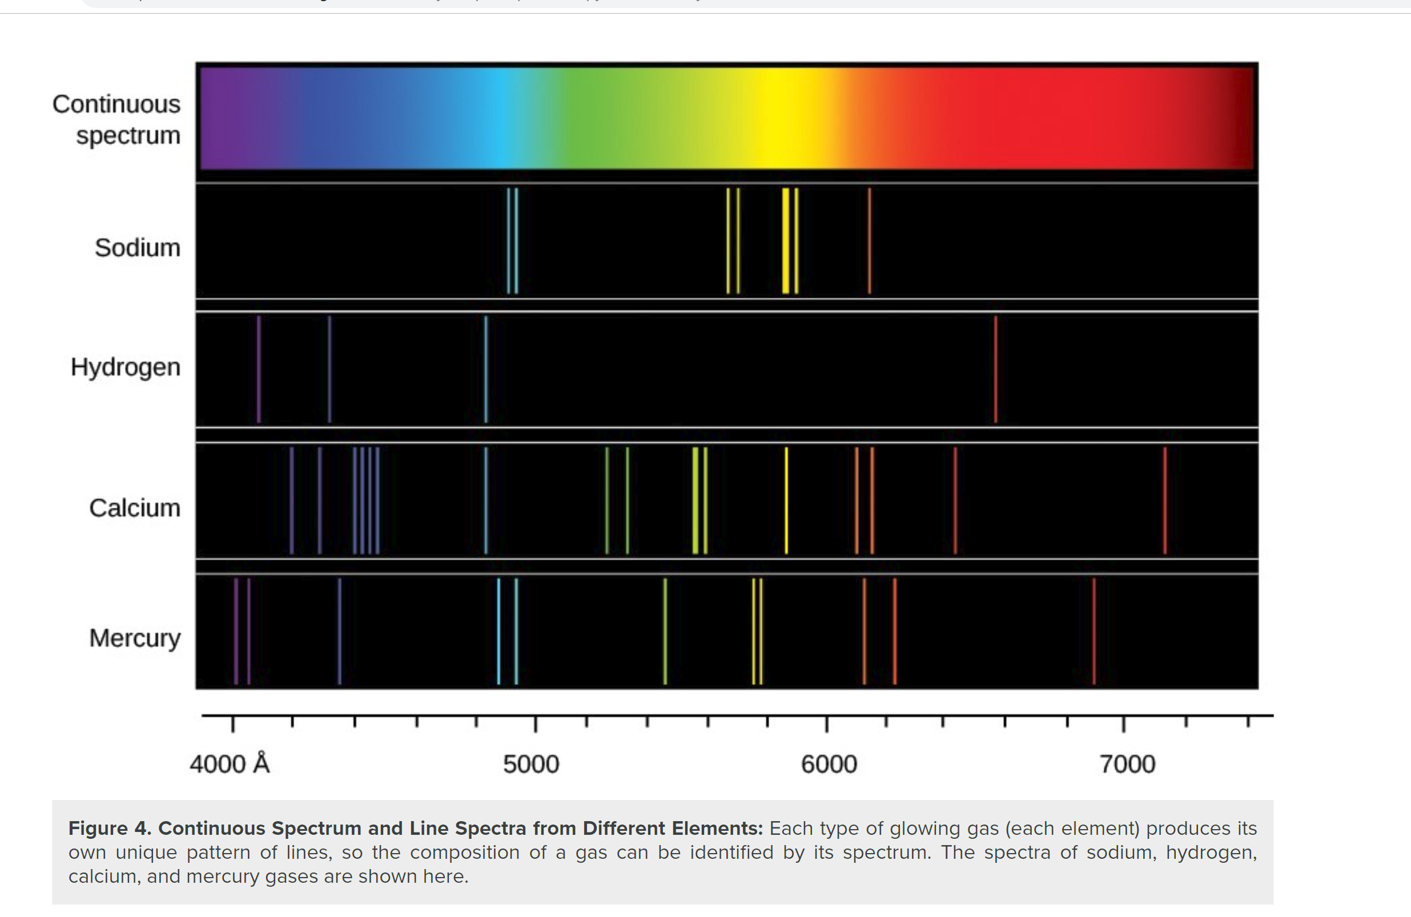

Slide 36


Slide 37
1. What are possible sources of error in this experiment?
2. How can the procedure be changed to reduce these sources of error?

Slide 38


Slide 39
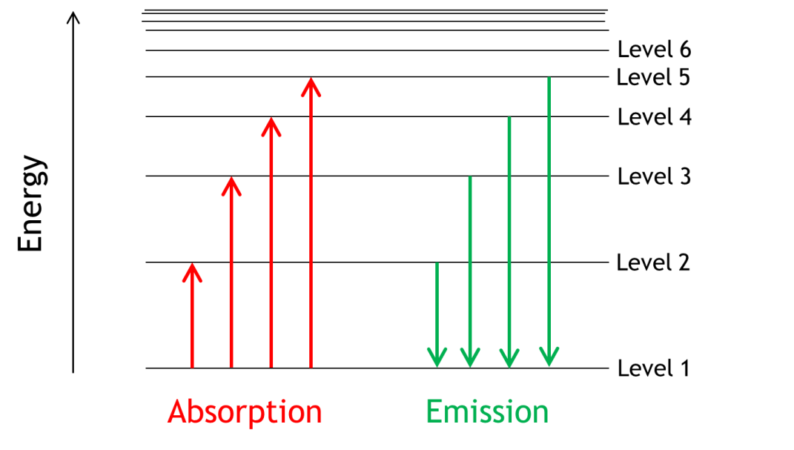
Ionisation Energy
The energy levels get more closely spaced, until they converge.
At this energy, the electron can escape from the atom.
The electron is free, the atom has been ionised: X_{(g)} → X⁺_{(g)} + e⁻
The energy needed is the ionisation energy.

